Slide 1
Liability API

Slide 2
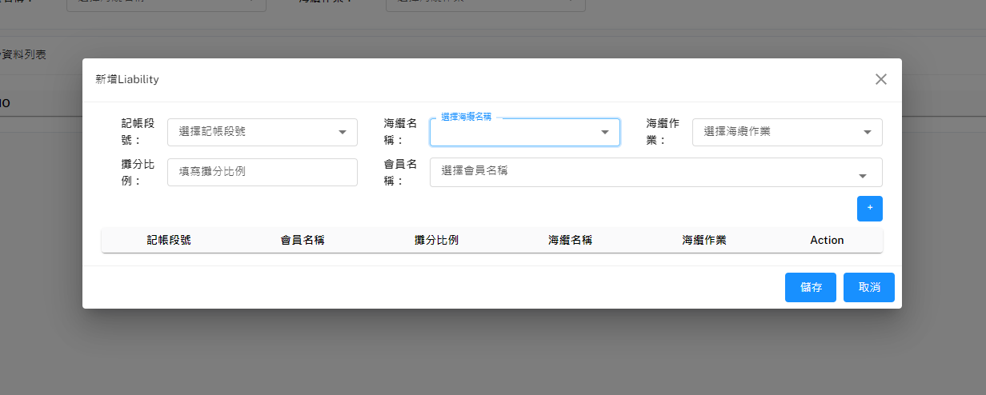
新增Liability
POST Body:
[
{
"SubmarineCable": "str",
"BillMilestone": "str",
"PartyName": "str",
"WorkTitle": "str",
"LBRatio": float
},
{...},
{...},
{...},
]
Method: GET
URL: http://127.0.0.1:8000/api/v1/SubmarineCables/all
Method: GET
URL: http://127.0.0.1:8000/api/v1/Parties/all
Method: POST
URL: http://127.0.0.1:8000/api/v1/compareLiability
Response: 1. {
"message": "No same data",
"compareResult": compareResultList
}
2. {
"message": "There some same datas",
"compareResult": compareResultList
}
如果得到的Response為第一種，"compareResult"的value會得到空矩陣
若是第二種則"compareResult"不是空矩陣
若是空矩陣才要進行增加Liability
POST Body:
[
{
"SubmarineCable": "str",
"BillMilestone": "str",
"PartyName": "str",
"WorkTitle": "str",
"LBRatio": float
},
{...},
{...},
{...},
]
Method: POST
URL: http://127.0.0.1:8000/api/v1/batchAddLiability

Slide 3
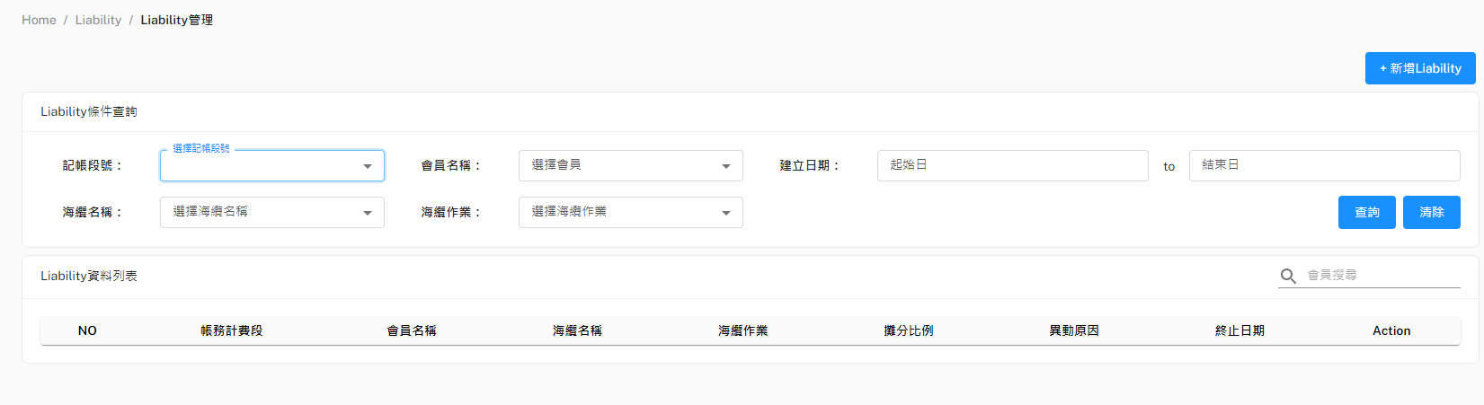
查詢Liability-1(下拉選單)
Method: GET
URL: http://127.0.0.1:8000/api/v1/dropdownmenuBillMilestone
Method: GET
URL: http://127.0.0.1:8000/api/v1/dropdownmenuSubmarineCable
Method: GET
URL: http://127.0.0.1:8000/api/v1/dropdownmenuParties
Method: GET
URL: http://127.0.0.1:8000/api/v1/dropdownmenuWorkTitle

Slide 4
查詢Liability-2
如果使用者有輸入篩條件就加在URL後面
http://127.0.0.1:8000/api/v1/Liability/BillMilstone=記帳段號&PartyName=會員名稱&SubmarineCables=海纜名稱&WorkTitle=海纜作業&startCreateDate=YYYYMMDD&endCreateDate=YYYYMMDD
沒有輸入任何條件
http://127.0.0.1:8000/api/v1/Liability/all

Slide 5
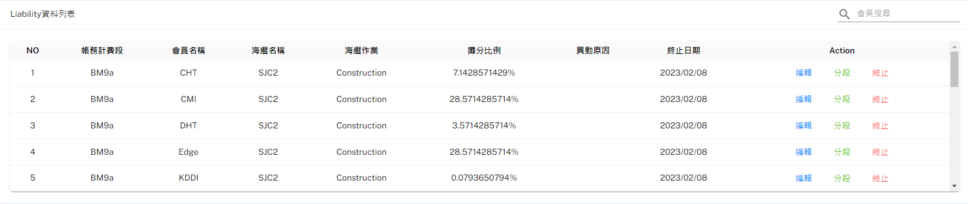
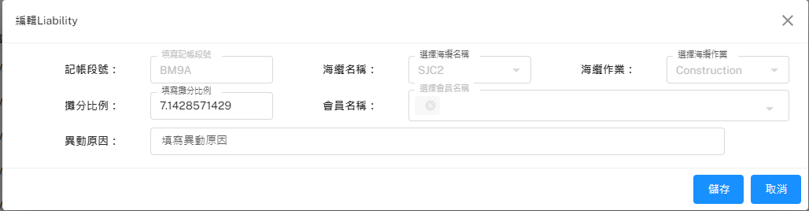
編輯(Update)Liability
Method: POST
URL: http://127.0.0.1:8000/api/v1/updateLiability
POST Body
{
"LBRawID": 1,
"SubmarineCable": "SJC2",
"BillMilestone": "BM12",
"PartyName": "VNPT",
"WorkTitle": "Construction",
"LBRatio": 7.1428571429,
}

Slide 6
終止Liability
Method: POST
URL: http://127.0.0.1:8000/api/v1/updateLiability
POST Body
{
"LBRawID": 1,
"EndDate": "2022-10-09 04:05:06"
}

Slide 7
Liability分段
{
"LBRawID": 1
}
Method: POST
URL: http://127.0.0.1:8000/api/v1/deleteLiability
POST Body
[
{
"SubmarineCable": "SJC2",
"BillMilestone": "BM12",
"PartyName": "VNPT",
"WorkTitle": "Construction",
"LBRatio": 7.1428571429,
},
{…},
{…}
]
Method: POST
URL: http://127.0.0.1:8000/api/v1/batchAddLiability

